Slide 1
CHAPTER 4
Customer Perceptions of Service

Slide 2
Chapter Objectives
Identify what influences customer perceptions of service and the relationships among customer satisfaction, service quality, and individual service encounters.
Demonstrate the importance of customer satisfaction, factors influencing it, and its outcomes.
Develop critical knowledge of service quality and its key dimensions – online and offline.
Discover ‘moments of truth’.

Slide 3
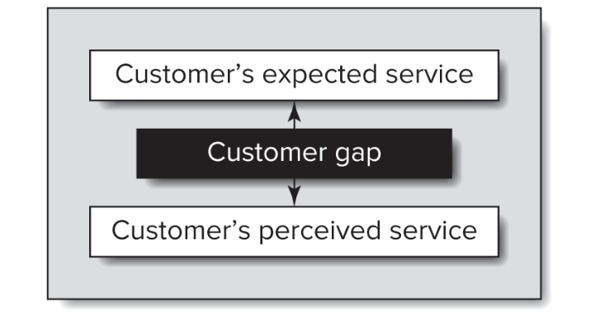
Customer Perceptions
How do customers finally perceive the service they have received (the outcome)?

Slide 4
To Keep in Mind
Perceptions are subjective
Expectations are dynamic (i.e., always changing or context dependent)
Things that satisfy customers today may be different tomorrow

Slide 5
Transaction-specific vs. Cumulative Customer Perceptions
Customers will have perceptions of single, transaction-specific encounters as well as overall perceptions of the company based on all the experiences.
Isolated encounters are building blocks for overall, cumulative perceptions.
Cumulative perceptions are likely to be better predictors of overall loyalty to a company.

Slide 6
Customer satisfaction is the customer’s evaluation of a product or service in terms of whether that product or service has met customer’s expectations.
Failure to meet expectations results in customer dissatisfaction.

Slide 7
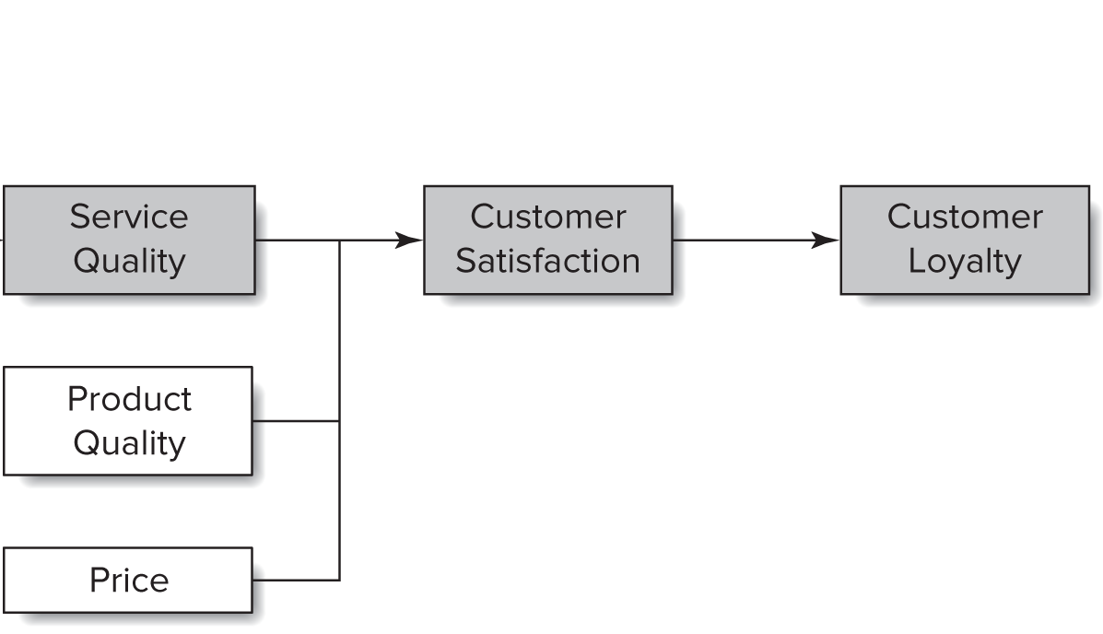
Customer Satisfaction vs. Service Quality
These two concepts are fundamentally different
Service quality: focuses on a dimension of service
Satisfaction: broader concept
Perceived service quality is one component the contributes to customer satisfaction (or dissatisfaction)
Notes:
Service quality is a focused evaluation that reflects the customer’s perception of reliability, assurance, responsiveness, empathy, and tangibles.
Customer satisfaction is more inclusive – it is influenced by perceptions of service quality, product quality, and price.

Slide 8
Product and Service Features
Firms need to determine which attributes or features are most important to their customers
Tools to help with this include – Surveys, Focus groups, Marketing research / empirical testing
Firms also need to determine which attributes customers will be willing to trade-off:
  Higher quality for higher price?
  Conjoint design is a great tool to help with this

Slide 9
Attributions to Service Success or Failure
Customers tend to look for reasons as to why they are satisfied or dissatisfied with a service.
Customers may attribute service success or failure to –
  Employees
  Price
  Interactions / other customers
Depending on what a specific customer attributes their feelings to, can also determine customer satisfaction.
Notes:
Often customers may also be partially responsible for how things turn out due to coproduction attribute of services.

Slide 10
Other Customers, Family Members, and Coworkers
Customer satisfaction may be influenced by other people.
Group dynamics, stories of other people, experiences of others may affect customer satisfaction
  Ex: not all members of a family will have the exact same customer satisfaction experience on a family vacation

Slide 11
Customers do not perceive service quality in a unidimensional context but rather judge it based on multiple context-relevant factors
What do you think are some determinants of service quality?

Slide 12




Service Quality Dimensions
Reliability
Assurance
Tangibles
Empathy
Responsiveness

Slide 13

Reliability
The ability to perform the promised service dependably and accurately.
Most important dimension in increasing customer perception of service quality.
Which companies do this well?

Slide 14

Assurance
Employees’ knowledge and courtesy and the ability of the firm and its employees to inspire customer trust and confidence.
This is especially important in services that are high-risk or CREDENCE.
What is an example of a high-risk service?

Slide 15
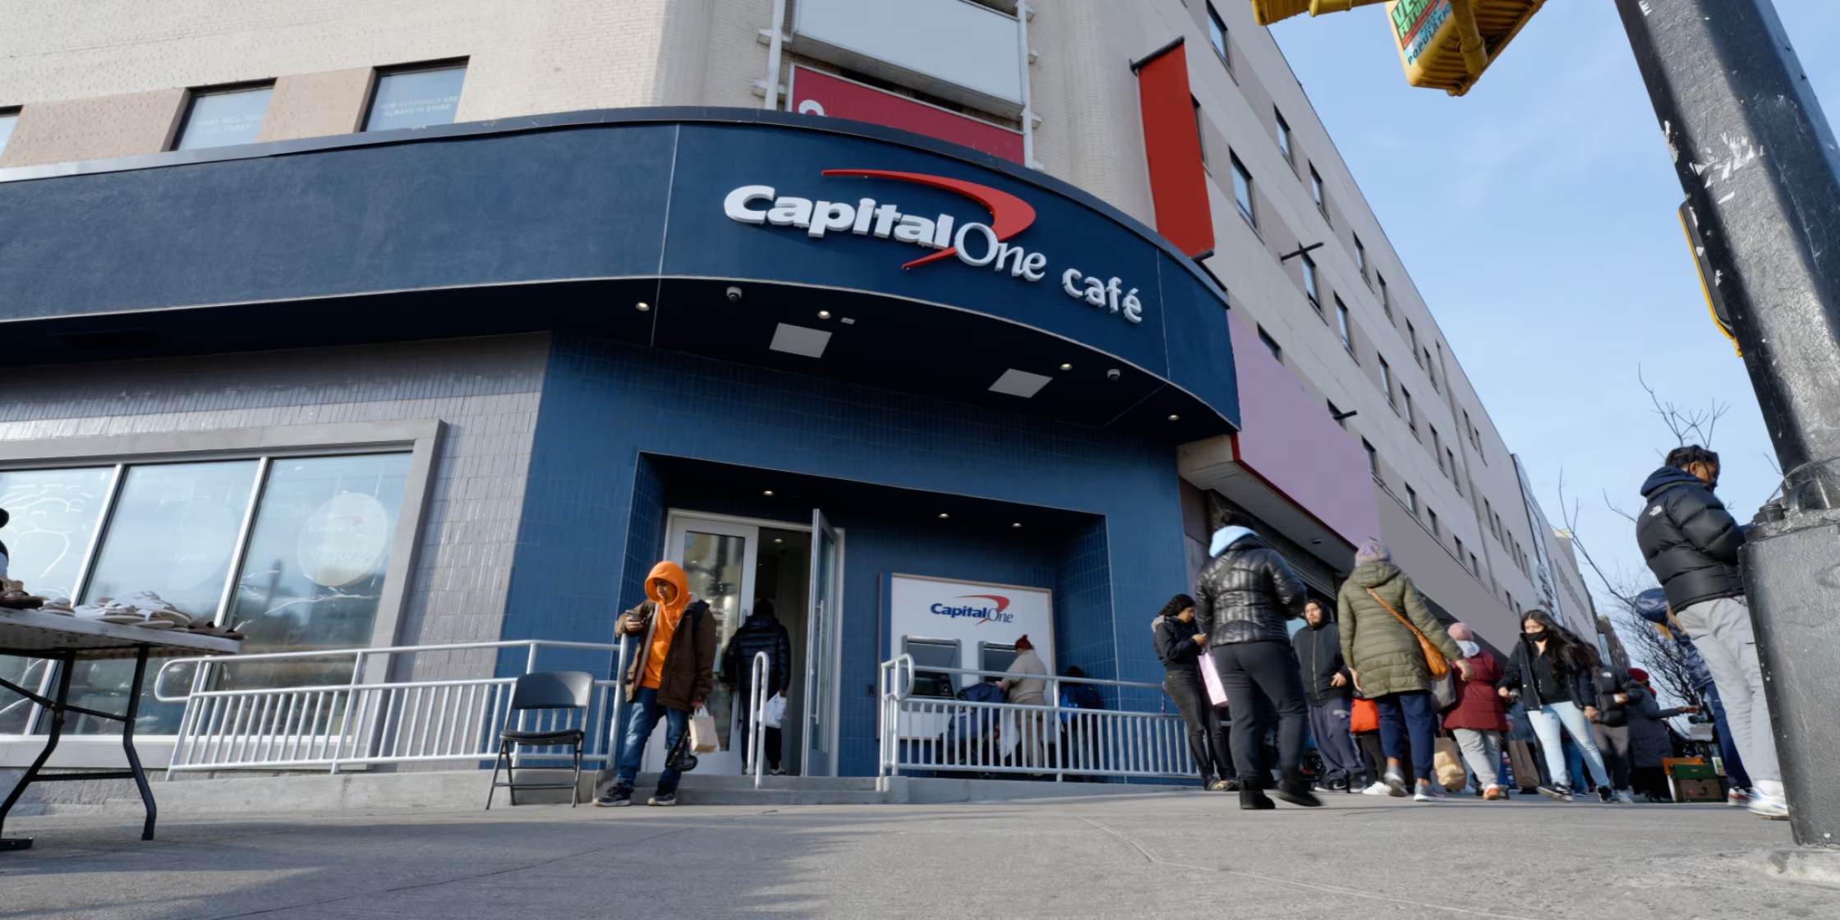
Tangibles
Representing the service physically through the appearance of physical facilities, equipment, personnel, and communication materials.
Used to enhance the company image, provide continuity, and signal quality.
Most companies combine this with another dimension to create a service quality strategy.

Slide 16
Empathy
The caring, individualized attention that the firm provides its customers.
This can be reflected in behaviors like knowing customers names, knowing customers preferences, etc.
Why do you think this would be important?

Slide 17
Responsiveness
The willingness to help customers and provide prompt service.
Thanks to technology, customers have high expectations and a ‘need for speed’ in company response.
To be successful in this dimension, a company needs to handle responsiveness from the customer’s point of view and not the company’s point of view.

Slide 18
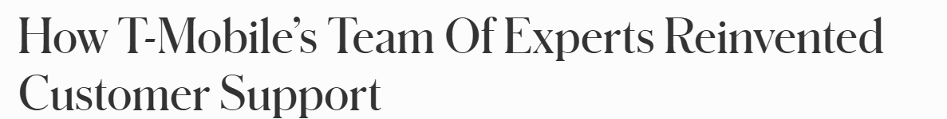
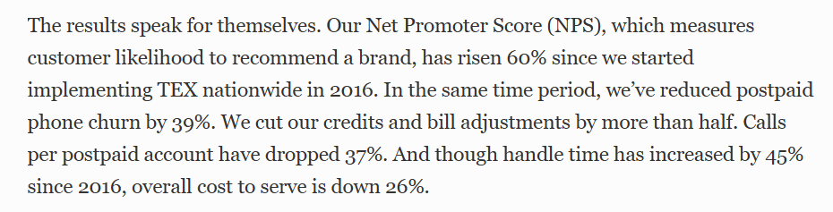
https://www.forbes.com/sites/tmobile/2019/11/14/how-t-mobiles-team-of-experts-reinvented-customer-support/

Slide 19
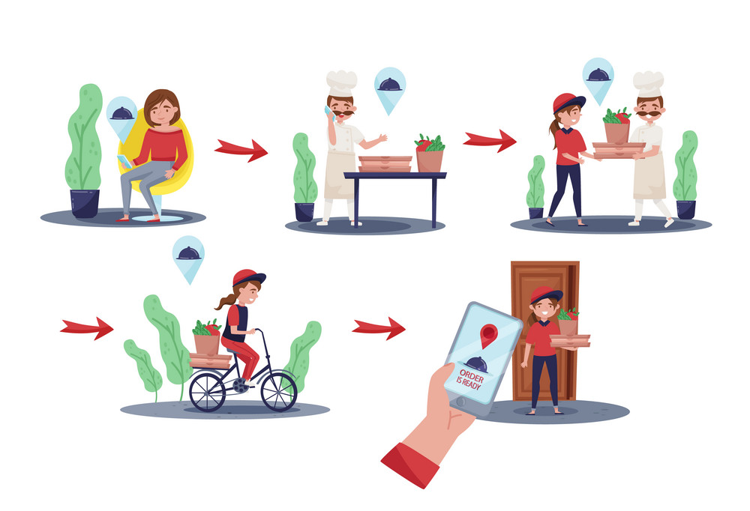
Service Encounters or “Moments of Truth”
A service encounter occurs every time a customer interacts with the organization
Customers use these encounters (the customer journey) to assess the organization’s service quality.
Each encounter is an opportunity to prove the companies’ potential.

Slide 20
Netflix case - encounters
Help Center — customer researches plans, features, or common questions.
Plan-selection screen — customer chooses a subscription plan.
Email or phone verification — customer verifies their identity or contact details.
Login screen — customer signs into Netflix.
Password-reset process — used if the customer cannot log in.
Kids profiles — customer creates a child-friendly profile.
Parental controls — customer sets maturity restrictions and viewing limits.
Personalized rows — Netflix presents content based on the customer’s preferences.
Search function — customer looks for a particular movie or series.
Video player — customer begins watching content.
Video-quality controls — customer adjusts streaming quality or data usage.
Skip Intro — customer skips a program’s opening sequence.
Buffering support — customer encounters and troubleshoots playback interruptions.
Recommendations — Netflix suggests content during and after viewing.
Notifications — customer receives updates about releases, recommendations, or account activity.
Live chat — customer contacts support when self-service options are insufficient.
Complaint handling — Netflix addresses an unresolved service or account problem.
Billing support — customer gets help with charges or payment issues.
Refund — an eligible disputed charge is reversed.
Billing or cancellation — customer manages payments, changes the plan, or ends the subscription.

Slide 21
Types of Service Encounters
Three types of service encounters exist: | What are important criterion to judge quality
Remote encounters: no direct human contact (e.g., ATM). | Tangible components; Technical specifications
Technology-mediated encounters: interaction through technology (e.g., text, online chat). | Tone of voice, Employee language
Face-to-face encounters: direct personal contact. | Most complex; both verbal and non-verbal behaviors. Tangible cues

Slide 22
Sources of Customer Dis/satisfaction in Service Encounters
Recovery – employee response to service delivery system failures
  Ex: A complaint from a client about an issue with software
Adaptability – employee response to customer needs and requests
  Ex: Requests made for software/ service customization
Spontaneity – unprompted and unsolicited employee actions
  Ex: Providing a service flow demo unprompted
Coping – employee response to problem customers
  Ex: a client not providing proper specifications and then creating issues

